Slide 1

Organizational Dynamic Capabilities Analysis

Slide 2
Agenda
General Project Context
Descriptive Analysis
Methodology
Findings and Next Steps

Slide 3




Technical and Conceptual Challenge
High Categorical Dimensionality
Multiple Levels and Subcategories
Analytical Approach Using Psychometric Instruments

Slide 4
Objective
This project aims to conduct a rigorous and exploratory analysis of a categorical psychometric dataset, in order to identify significant patterns, reduce dimensional complexity, and evaluate analytical models that provide a deeper and more useful understanding of the response structure. This understanding will guide the selection of tools that enhance the interpretability and informational value of the instrument

Slide 5

Descriptive Statistics

Slide 6
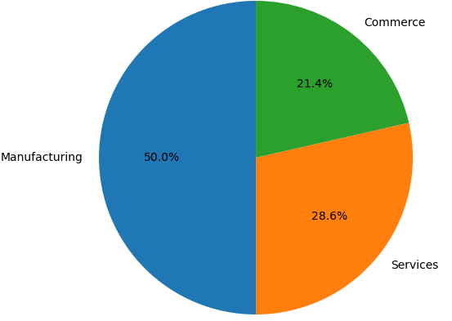
Percentage Distribution by Industry
The analyzed sample shows a significant concentration in the manufacturing sector, which accounted for 50% of the surveyed companies
This distribution suggests that any subsequent (comparative or inferential) analysis should take into account the potential influence of this sector on the results obtained

Slide 7
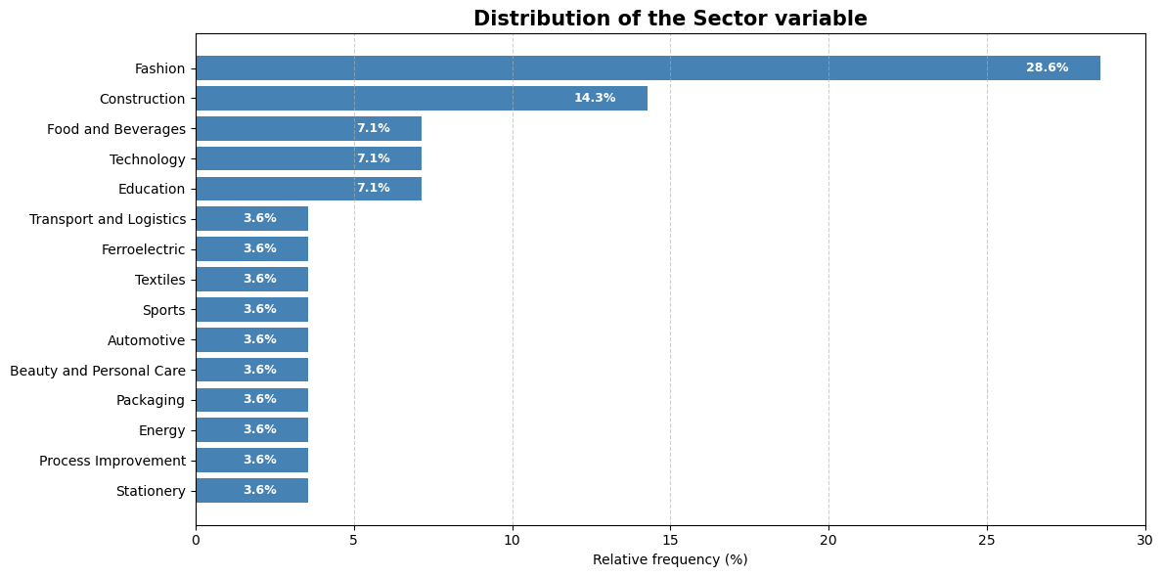
Percentage Distribution by Sector
The sectoral distribution reveals a strong concentration in economic activities related to the fashion industry (28.6%). In contrast, the high dispersion of the remaining sectors, each with marginal representation, will limit the ability to draw solid group-level inferences at the sectoral level

Slide 8
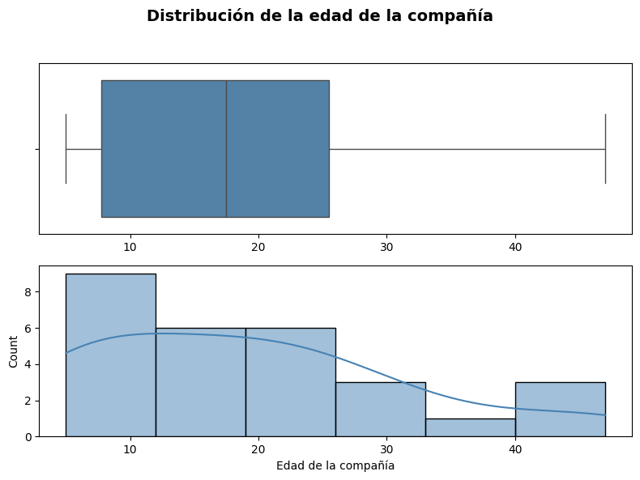
Company Age Distribution
The sample is predominantly composed of companies with a median age close to 18 years and a high concentration under 25 years
This skewed distribution toward younger companies should be taken into account when interpreting the results of the selected models, as company age may influence organizational maturity

Slide 9
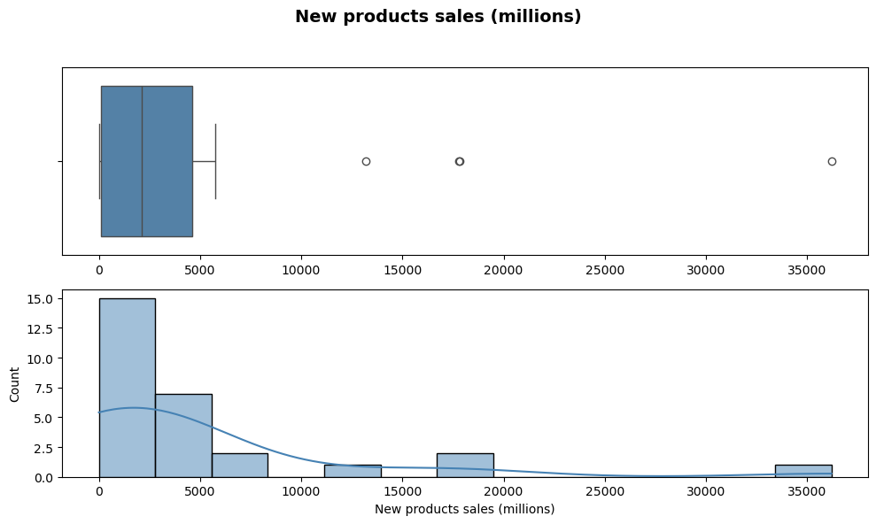
Company Sales Distribution
The sales distribution shows that most companies have revenues concentrated between COP 500 million and COP 7 billion, with a median of approximately COP 2.5 billion. However, there are some outliers with significantly higher sales, reaching up to COP 36 billion.

Slide 10
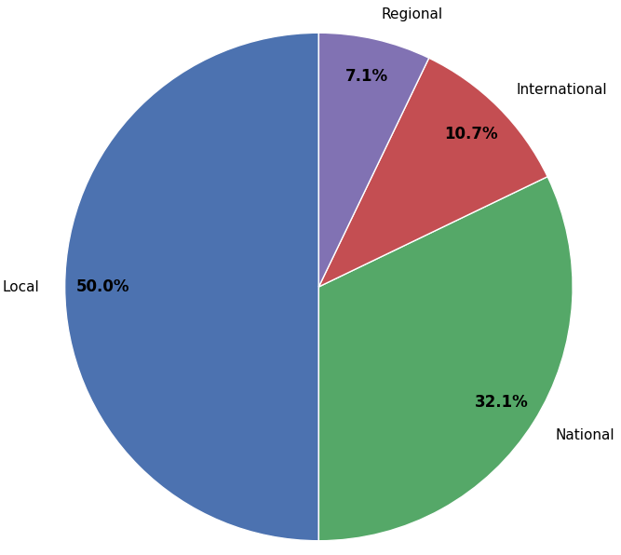
Geographic Distribution of Companies (%)
Half of the surveyed companies operate exclusively at the local level, while only 10.7% have an international reach. This will be validated with the results from the latent variable analysis to assess whether companies with limited territorial coverage exhibit a lower propensity to scale innovation or transformation processes

Slide 11
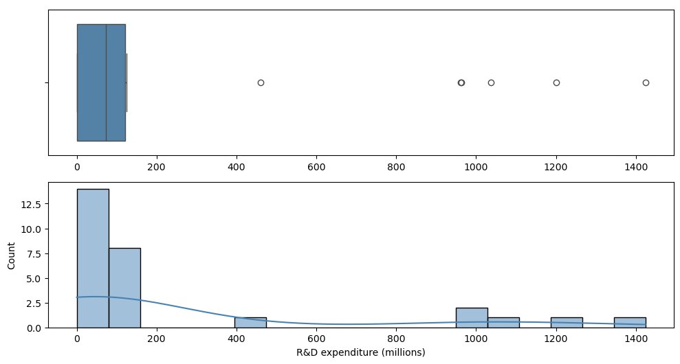
R&D Expenditure Distribution
The analysis of R&D investment reveals a clear concentration of companies investing less than COP 200 million, with a median expenditure close to COP 80 million. However, the presence of several outliers over COP 1 billion highlights the wide dispersion in the data.
This level of variability indicates that innovation investment strategies differ significantly across firms, suggesting that any relationship with organizational capabilities should be examined carefully in subsequent phases of the study

Slide 12
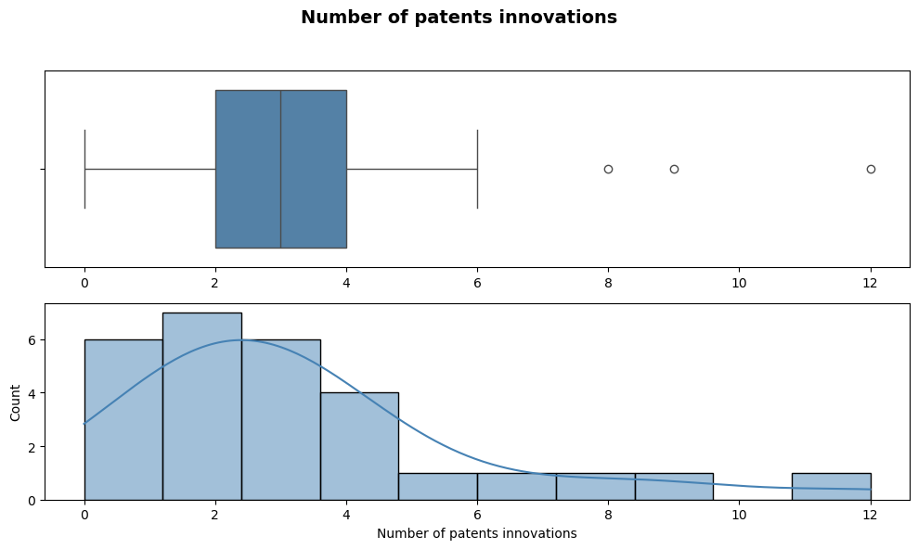
Number of Patents Distribution
The median number of patents is around three, with a significant group reporting between two and five. This suggests the presence of firms that do systematize their innovation processes potentially linked to more mature internal structures, dedicated R&D units, or consistent innovation efforts

Slide 13
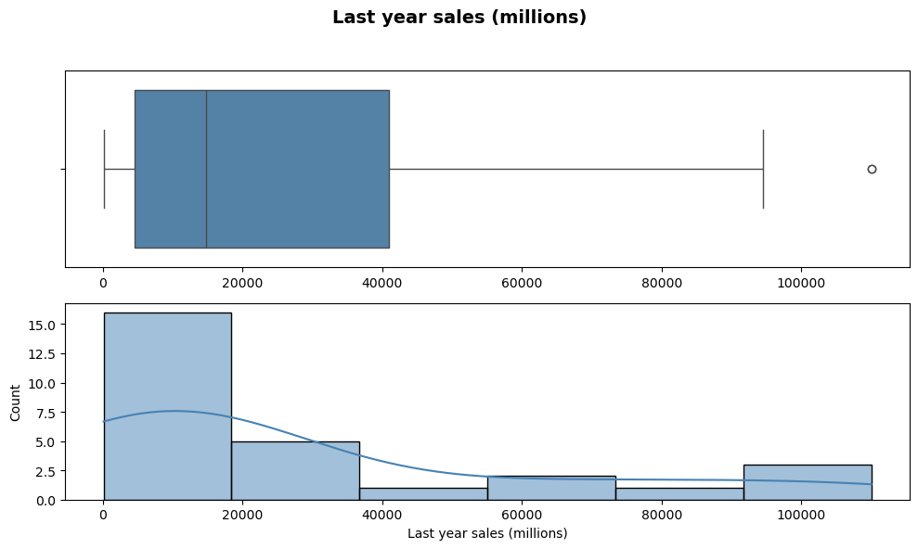
Last Year Sales Distribution
The distribution of annual sales reveals significant heterogeneity in the economic scale of the companies, with a median close to COP 20 billion and values exceeding COP 100 billion. This level of variability may have important implications for firms’ capacity to implement processes, adopt technologies, or execute transformation strategies. As such, it should be carefully considered when interpreting the results

Slide 14
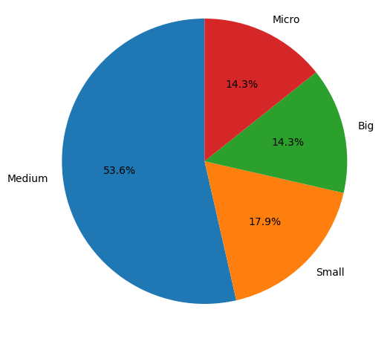
Percentage Distribution by Company Size
This composition suggests that the analysis results will be predominantly shaped by firms with intermediate organizational structures. This factor should be taken into account when interpreting differences in organizational capabilities, as company size can influence available resources, the formalization of processes, and the capacity for adaptation

Slide 15
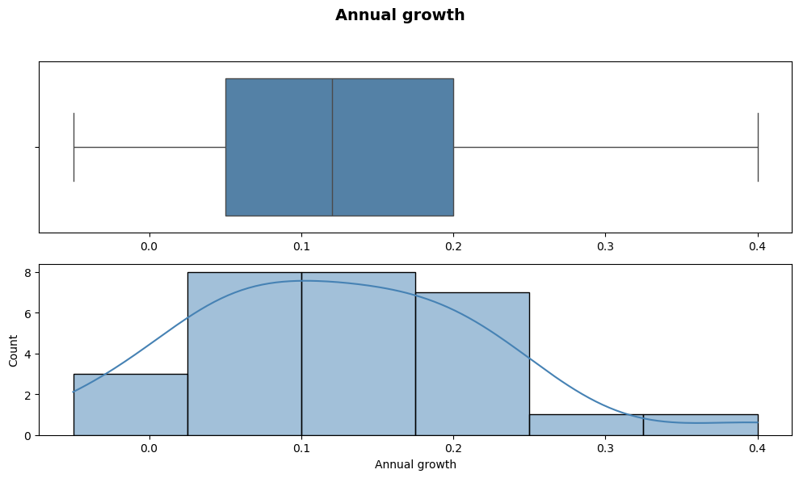
Annual Growth Distribution
The distribution of annual growth shows a median of 12%, with most companies concentrated between 5% and 20%. While the overall average is moderate (12.5%), there are also cases of negative growth as well as firms exceeding 30%. This variability highlights clear differences in companies’ growth dynamics, which may influence their ability to invest, adapt, or transform internal processes

Slide 16

Selección del Modelo
Methodology

Slide 17
Data Preparation
Three major information domains were defined to guide the analysis: Sensing, Seizing, and Transformation.
II. Each domain was divided into four subcategories: Performance, Offer Value Proposal, Process and Tools, and People.
III. The lists of columns corresponding to each subfactor were dynamically generated.

Slide 18
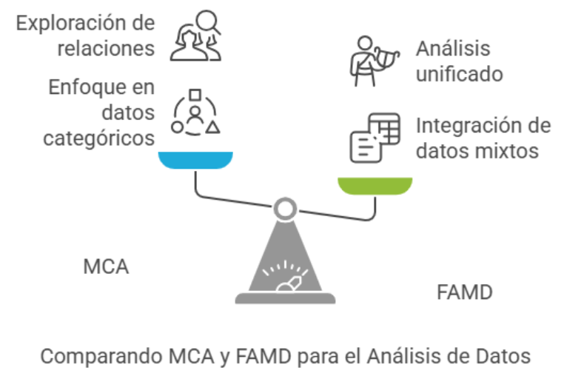
Exploración de diversos modelos

Slide 19
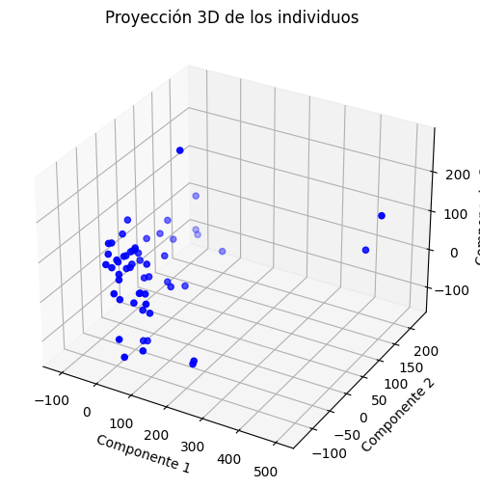
Exploración de diversos modelos

Slide 20
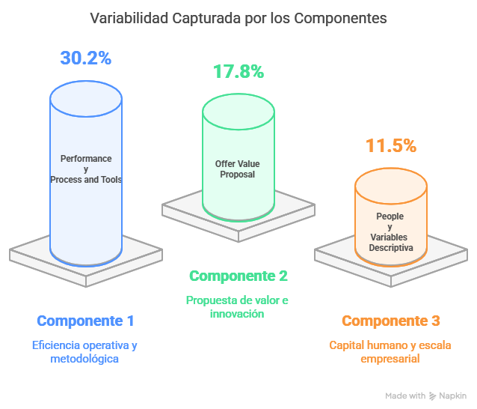
Exploración de diversos modelos

Slide 21
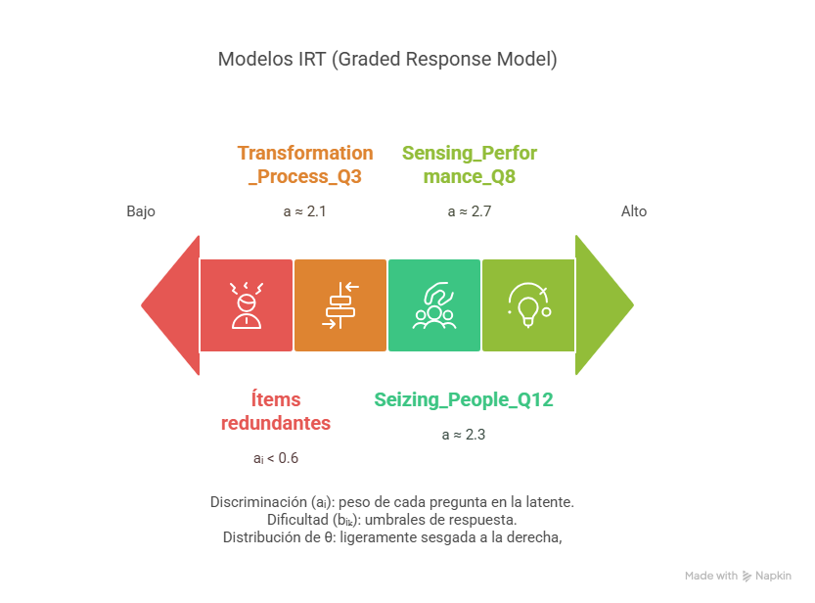
Exploración de diversos modelos

Slide 22
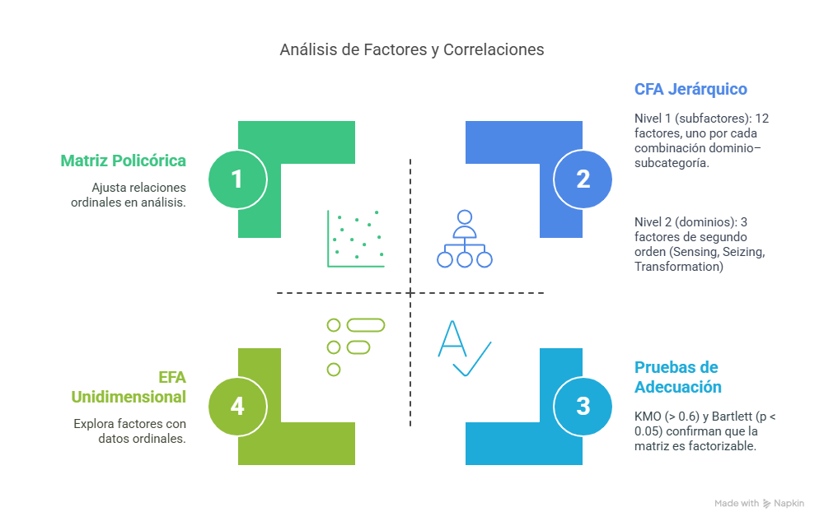
Exploración de diversos modelos

Slide 23
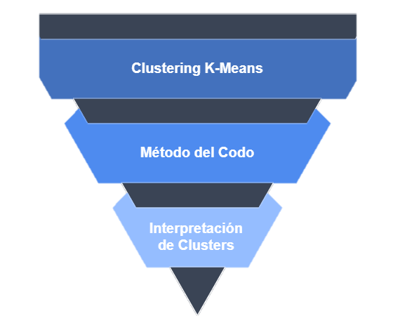
Exploración de diversos modelos

Slide 24




Selected Methodological Approach Item Response Theory (IRT)
Definition
Principles**
It is a statistical approach used to model the relationship between an unobservable latent variable and the observed responses to a set of items (questions)
Practial Relevance
The probability of a given response depends on two components:
Company characteristics (position on the latent variable)
Item characteristics (difficulty, discrimination, etc.)
$$P\left(X=1\right|θ)=f(θ, item parameters)$$
Construction of valid and accurate measurements that go beyond simple response summation
Adjustment for differences in item difficulty and discrimination
Generation of comparable indices across companies
Reduction of measurement bias and improvement in data quality
Example: skills, attitudes, or organizational capabilities
*Each model varies depending on the type of item (dichotomous vs. polytomous), the number of parameters, and the type of function used to describe the response probability
Notes:
Nota: a diferencia de los métodos clásicos de puntuación que simplemente suman las respuestas, IRT reconoce que:
-Los ítems pueden diferir en dificultad y calidad.
-No todas las respuestas reflejan el mismo nivel de la variable latente.
-El error de medición no es constante: depende del nivel de habilidad de quien responde.
En resumen: IRT permite inferir el nivel real de una capacidad no observable (como las capacidades dinámicas de una empresa) a partir del patrón de respuestas a una serie de ítems calibrados estadísticamente

Slide 25
Methodological Approach Polytomous Rasch Model (PCM)
Key Features
Key Advantages
Implementation
Model characterized by a single parameter corresponding to item difficulty
Assumes that all items have the same discrimination power
Ideal model for ordered scales, such as Likert-type questions
Produces a linear and objective scale
Facilitates instrument validation, allowing assessment of response fit
Ideal for building a robust and parsimonious index of dynamic capabilities
In the project, it was used to estimate a general index based on the selected questions, which enabled the construction of a compact measure of the capabilities of the evaluated companies
Notes:
Nota: a diferencia de los métodos clásicos de puntuación que simplemente suman las respuestas, IRT reconoce que:
-Los ítems pueden diferir en dificultad y calidad.
-No todas las respuestas reflejan el mismo nivel de la variable latente.
-El error de medición no es constante: depende del nivel de habilidad de quien responde.
En resumen: IRT permite inferir el nivel real de una capacidad no observable (como las capacidades dinámicas de una empresa) a partir del patrón de respuestas a una serie de ítems calibrados estadísticamente

Slide 26
Alternative Methodological Approach Graded Response Model (GRM)
Key Features
Key Advantages
Implementation
Model characterized by two parameters: item difficulty and discrimination power
Allows each item to have a different ability to discriminate between levels of skill (or propensity)
Model specifically designed for ordinal questions
Captures nuances in item quality
Maximizes measurement precision across the range of the latent variable
Enables the development of differentiated indices for specific dimensions (e.g., Sensing, Seizing, and Transformation)
For each of the dynamic capability dimensions captured in the survey (Sensing, Seizing, and Transformation), a GRM model was estimated, producing latent indices that offer greater sensitivity in capturing differences across companies.
Notes:
Nota: a diferencia de los métodos clásicos de puntuación que simplemente suman las respuestas, IRT reconoce que:
-Los ítems pueden diferir en dificultad y calidad.
-No todas las respuestas reflejan el mismo nivel de la variable latente.
-El error de medición no es constante: depende del nivel de habilidad de quien responde.
En resumen: IRT permite inferir el nivel real de una capacidad no observable (como las capacidades dinámicas de una empresa) a partir del patrón de respuestas a una serie de ítems calibrados estadísticamente

Slide 27
Comparative Analysis of Models
Aspect | Rasch Model (PCM) | GRM Model (Graded Response Model)
Model type | 1 parameter (difficulty only) | 2 parameters (difficulty and discrimination)
Assumption about discrimination | All items have equal discrimination | Each item has its own discrimination
Optimal when | Items are homogeneous in psychometric quality | Items vary in their discriminative power
Main advantage | Simplicity, interpretability, and instrument validation | Flexibility and greater precision in measurement
Model complexity | Low (fewer parameters) | Medium (more parameters)
Results in this project | Slightly better log-likelihood, better AIC and BIC in some cases | Better AIC and BIC overall, best general fit
Fit interpretation | Objective scale, but limited fit | Better fit to actual data
Recommended model | Useful as initial reference and validation | Selected model for final analysis
Criteria | GRM | PCM | Best Model
AIC | 11048 | 12150 | GRM
BIC | 11846 | 14244 | GRM
loglike | -5130 | -5040 | PCM

Slide 28
Results

Slide 29
Guiding Question
Is there a statistically significant relationship between a company's propensity to engage in sensing-related activities and its size and sales from the past year?

Slide 30
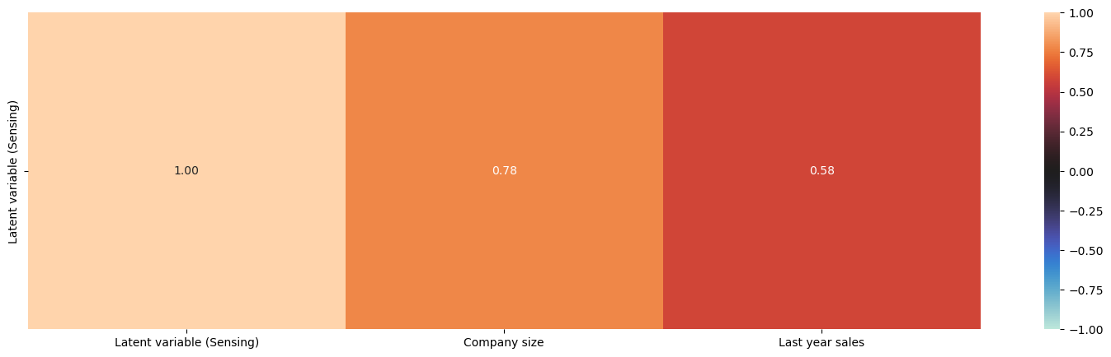
Correlation Analysis
There is a strong and positive linear correlation between company size and propensity for sensing
There is a moderate and positive linear correlation between last year's sales and propensity for sensing.

Slide 31
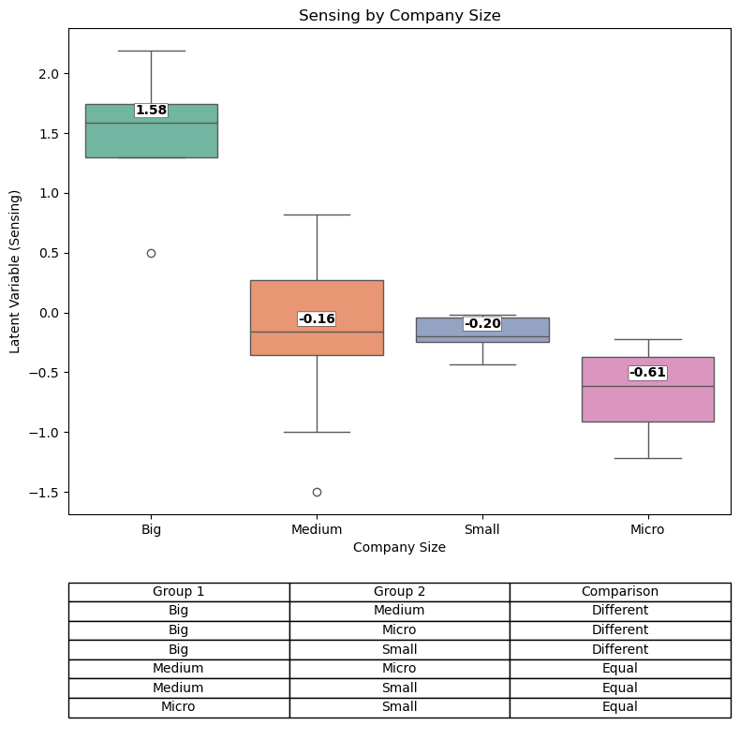
Bivariate Analysis Latent Variable (Sensing) vs. Company Size
The median values of propensity for sensing follow a downward trend as company size decreases.
Large companies show higher levels of propensity for sensing compared to other size categories. However, is this difference statistically significant?

Slide 32
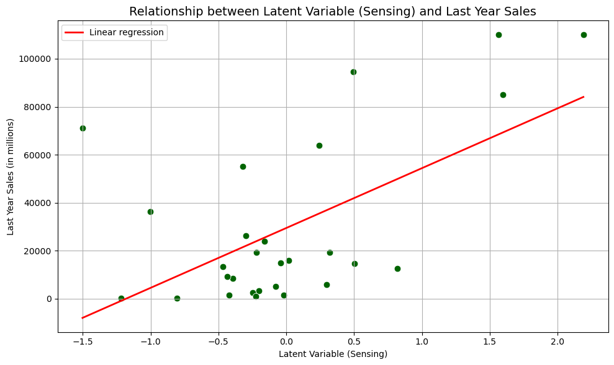
Bivariate Analysis
Latent Variable (Sensing) vs. Sales in the Last Years

Slide 33
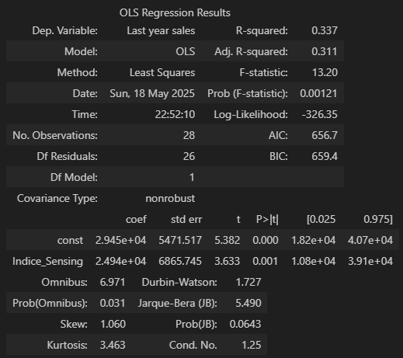
Bivariate Analysis
Latent Variable (Sensing) vs. Last Year’s Sales
33.7% of the variability in a company’s sales from the last year can be explained by the sensing index
There is a statistically significant relationship between last year’s sales and the propensity for sensing
For each additional unit in the sensing index, sales are expected to increase by an average of COP 24.9 million

Slide 34
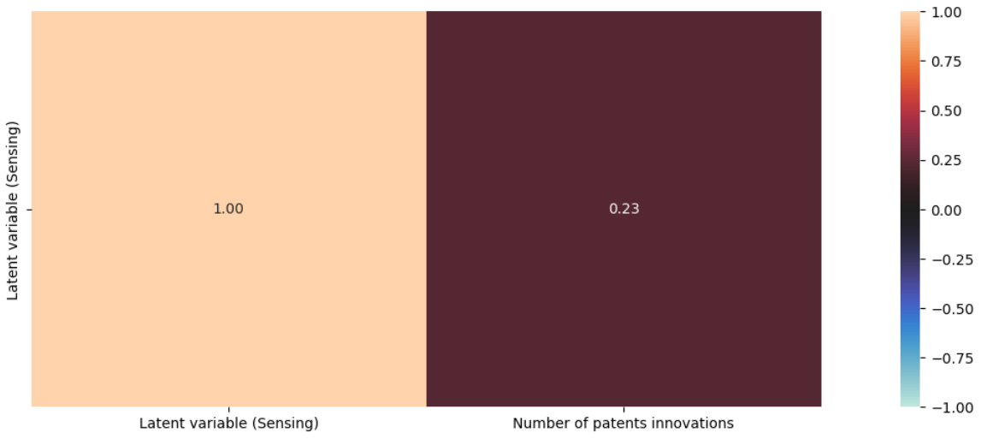
Bivariate Analysis Latent Variable (Sensing) vs. Number of patents
There is a weak and positive linear correlation (Pearson) between number of patents and propensity for sensing.
Correlation ratio Kendall: 0.1294.
Correlation ratio Spearman: 0.1454.

Slide 35
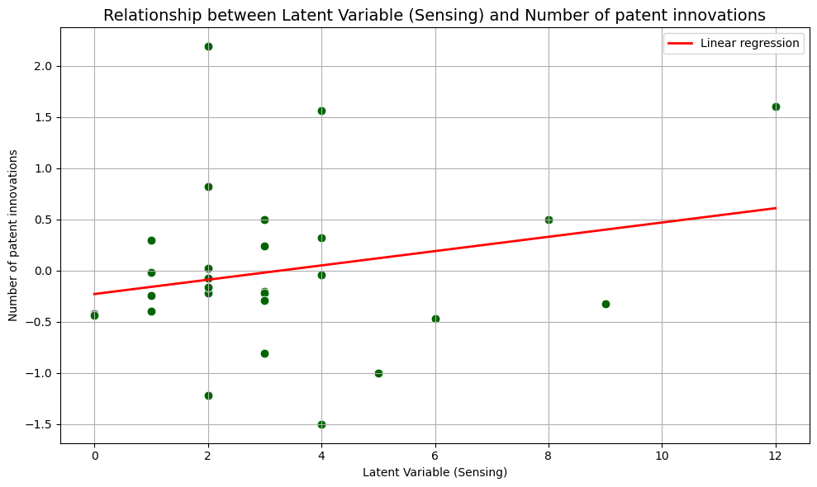
Bivariate Analysis
Latent Variable (Sensing) vs. Number of patents

Slide 36
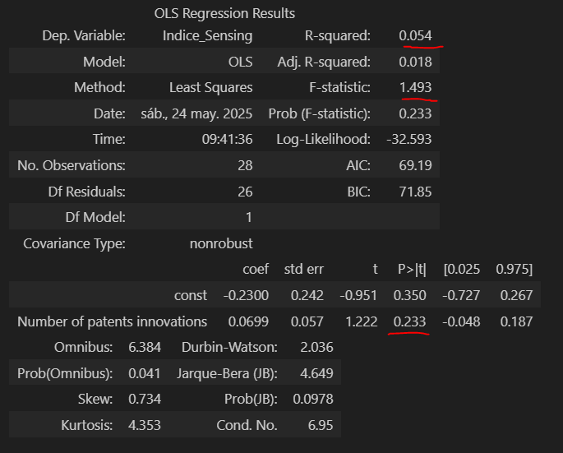
Bivariate Analysis
Sensing Index vs. Number of patents
The model is not significant.
There is no statistical evidence that the number of patents has a significant effect on the Sensing.
The model explains very little variance (5.4%). The relationship is weak.

